Slide 1




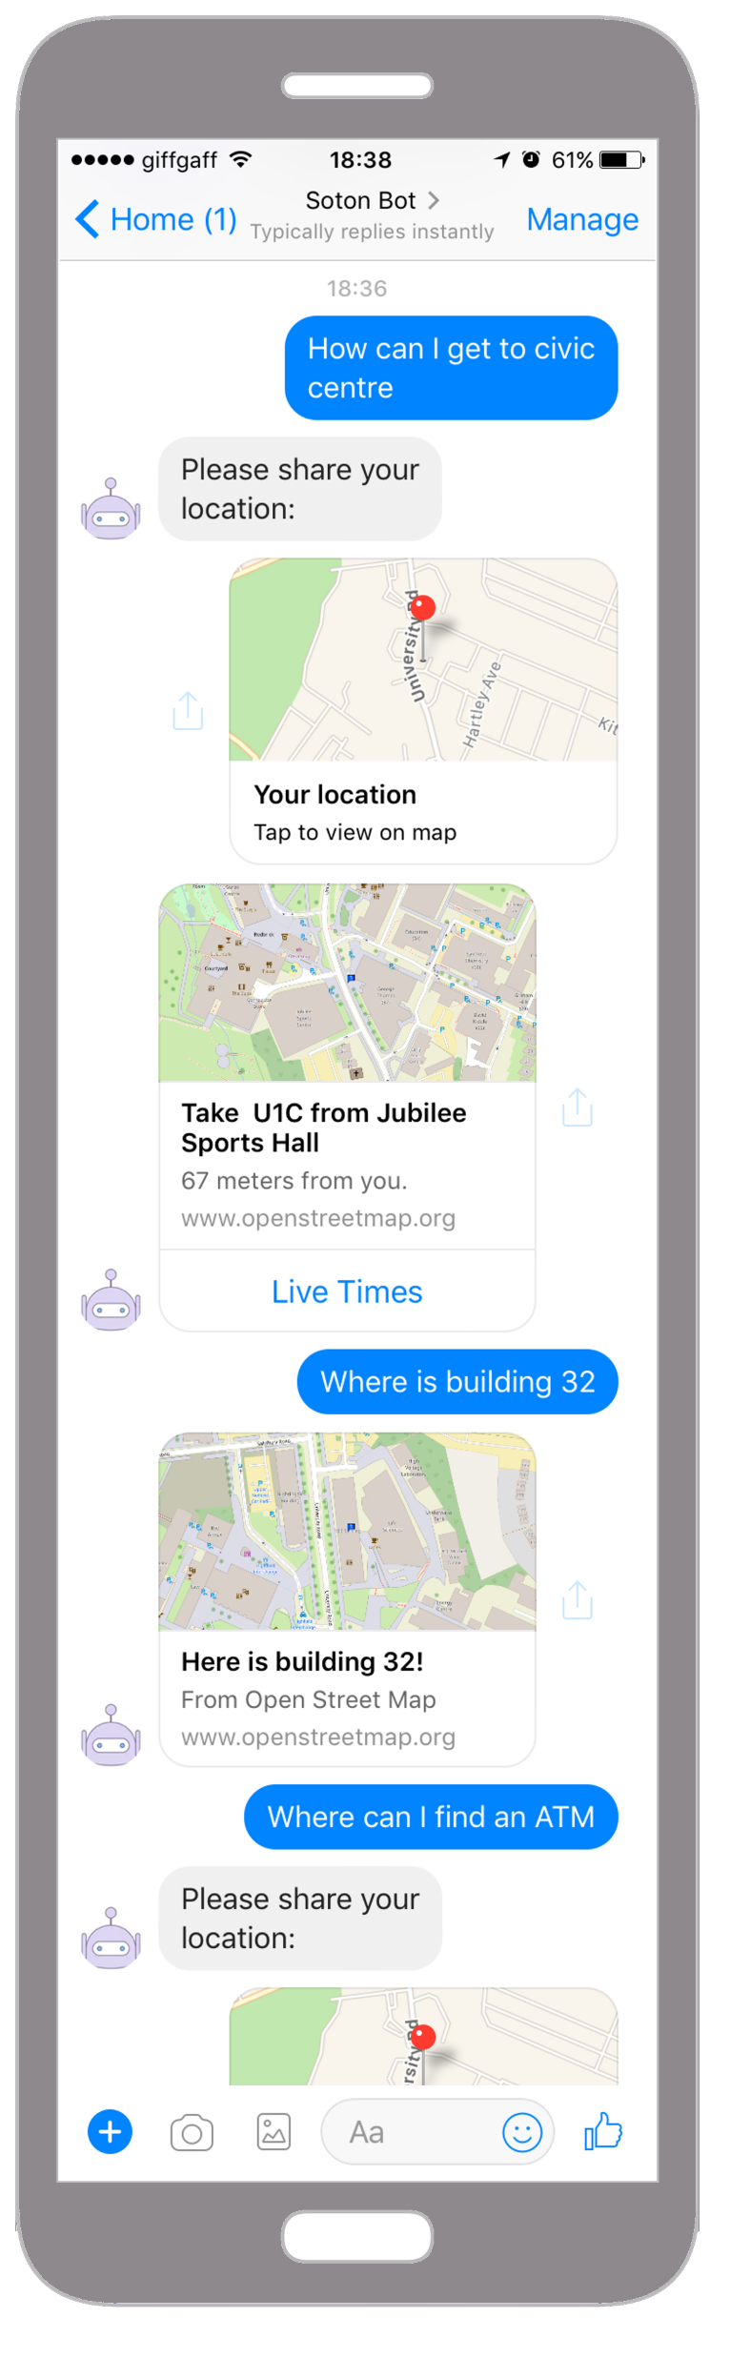
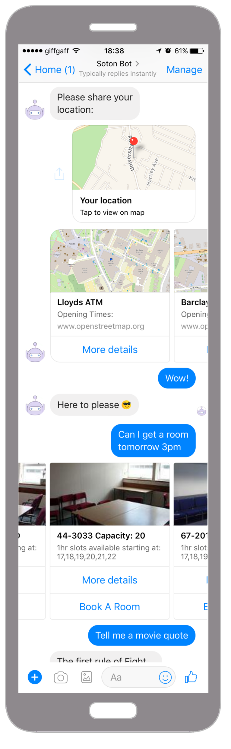
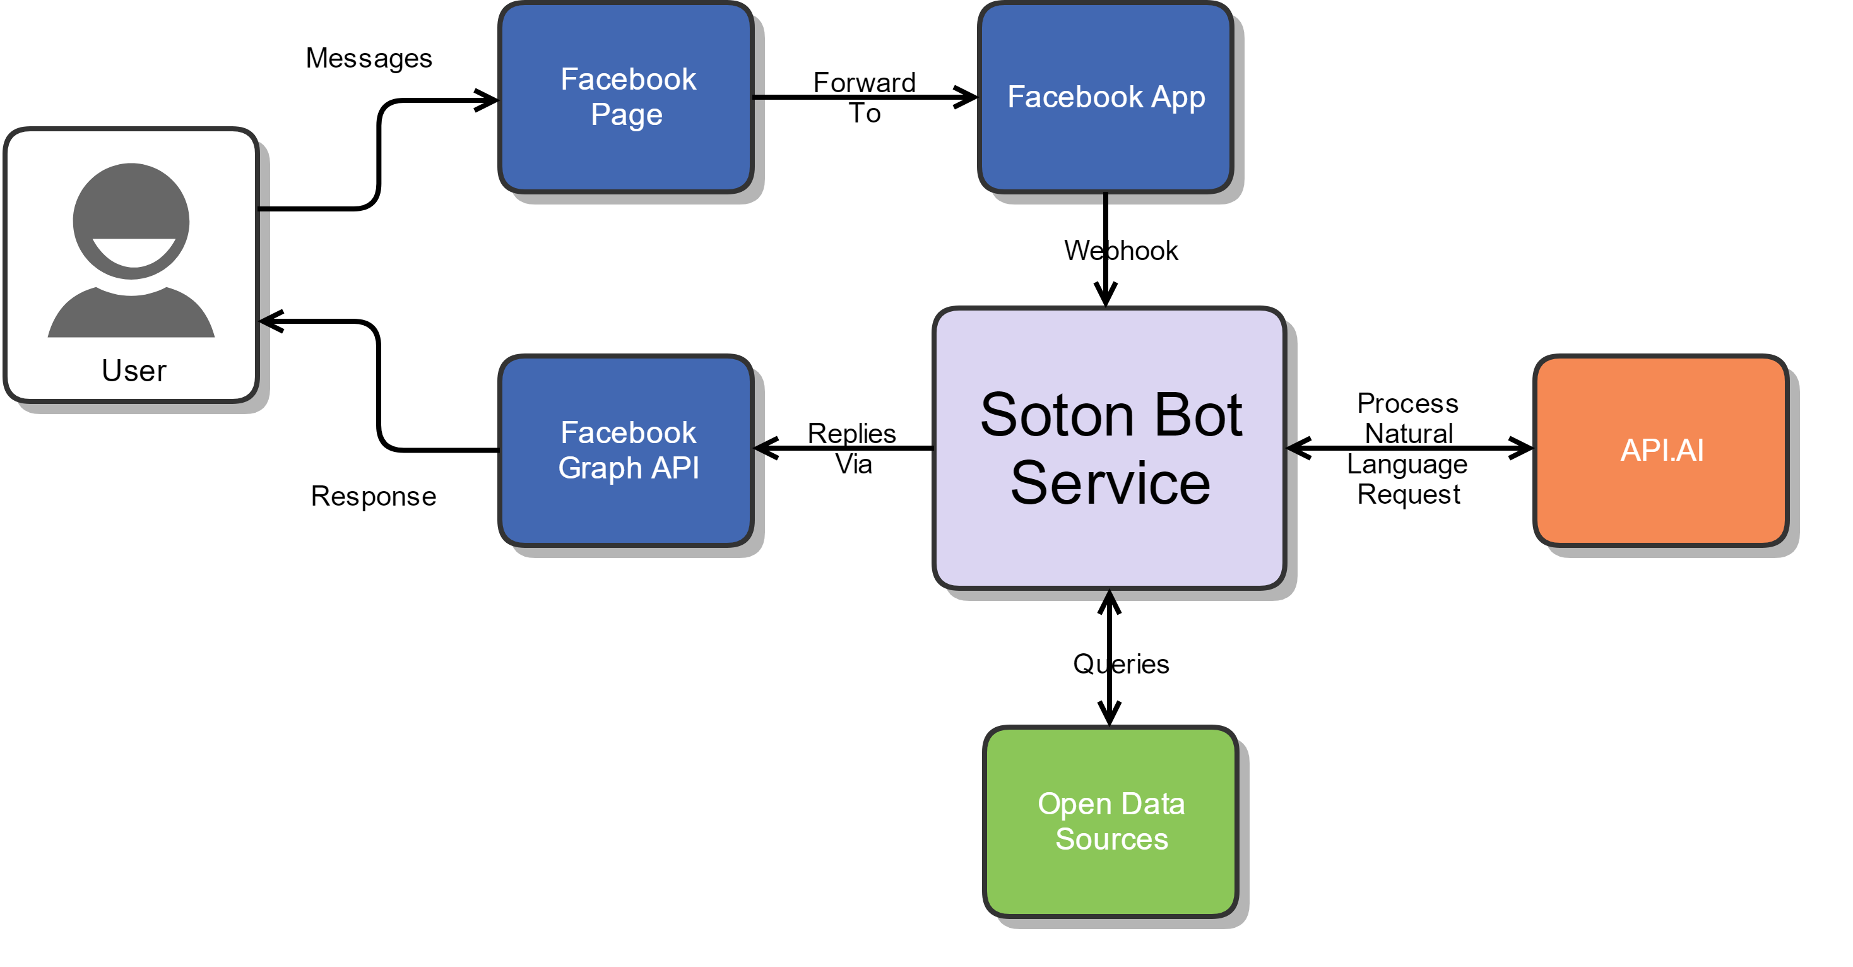
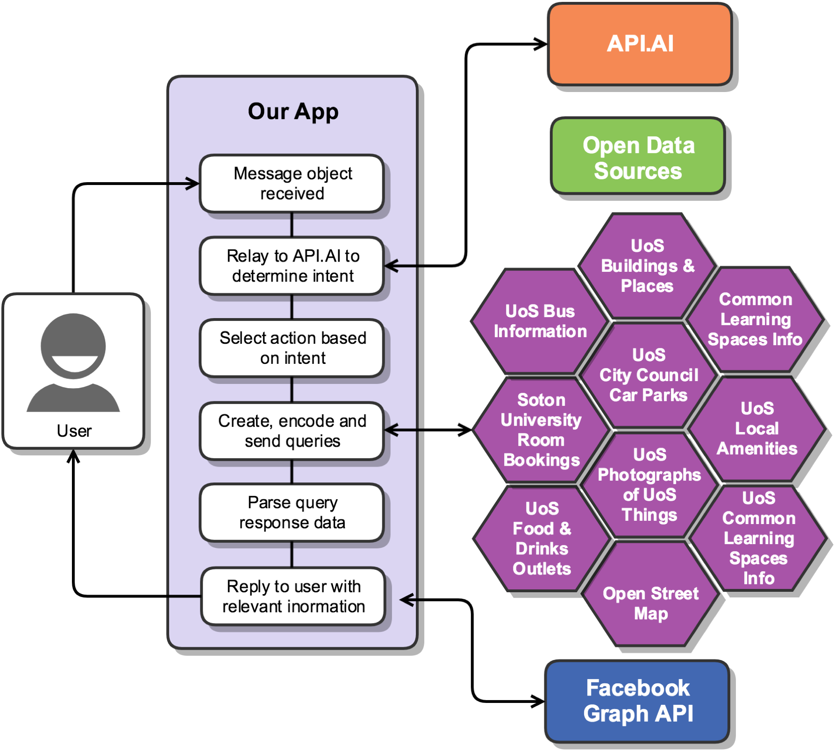
SOTON BOT
OPEN DATA INNOVATION COMP6214
￼
Team One
Lendina Hykaj, Stefan Collier, Deepak Thankachan, Shakib-bin Hamid, Tom Aley
ABSTRACT
METHODS
BOT SKILLS
“Make it and they will come”, however they (users, developers, etc.) didn't. The university has opened up significant amounts of data which are sadly split over many different websites and services. The majority of users are not aware of the existence of these data sources.
This bot consumes many sources of data and makes them accessible from a single location: Facebook messenger. With 1.2 Billion People on messenger, including almost every student and most staff on campus, it already has the reach.
Rather than going to various sites to find useful information for the university, you would just talk to the bot in natural language in your favourite chat platform, as you would with a friend!
Soton Bot is here to rescue us from the hoard of services and help us make the most of our campus.
ARCHITECTURE
Find Buses
Where is the nearest bus stop?
Find Essentials
How can I get to civic centre?
Car parking
Locate Places To Eat
Where is an atm?
KEY COMPONENTS
Facebook business account to manage a Facebook Page and Facebook App.
API.AI account to change natural language questions into actionable intents.
SOTON BOT’s NodeJS implementation hosted on Heroku.
Open Data!
Where can I get some coffee?
Access Room Details
Food please
Find me a room tomorrow
Find a free room next week Tuesday?
Discover Campus Buildings
BACKGROUND
Where is building 32?
PROBLEM University offers a lot of open data services.
Students do not know that half of these exist or where to find them.
Even when the information is found, it is not catered to answer simple and targeted queries.
Let’s not build yet another website!
SOLUTION Make the data accessible from one of the most well known communication tools and let users access it in natural language.
BOT BENEFITS
FURTHER WORK
Save Money
The Bot has a very simple infrastructure
There is no need to design a website
Sell Framework
Framework could be sold to other institutions
Maintenance and upgrade contracts would be drawn
Showcase Open Data
Demonstrate Power of Open Data
Encourage Standards Conformity in order for service to be “Plug N’ Play
Pass the Facebook review in order to make it live.
Extend skillset to include lecture location using module.
Improve live times.
CONCLUSION
The bot responses have been tested manually and through automated testing – unit and integration. It will require further refining, but we believe that the solution can truly benefit the university and other similar open data ventures.
DATASETS
For additional information please contact:
Dr Sepi Chakaveh or the team
Electronics and Computer Science
University of Southampton
sc2@ecs.soton.ac.uk or cloud.group.e@gmail.com

